Slide 1
Software Installation

Slide 2
Pre-workshop
Install R (version >4.0.0)
Install Rstudio
Go to: github.com/jevanilla/tenc-rshiny-workshop
Clone or download repository
Set your working directory to /rshiny-workshop
Run the ‘setup.R’ script

Slide 3
Introduction to Developing Interactive Web Applications with Shiny in R
Johnathan Evanilla
Tandy Center for Ocean Forecasting, Bigelow Laboratory for Ocean Sciences
Tribal Exchange Network Conference
15 October 2024

Slide 4
Workshop Outline
Software Installation
Introductions (you + me)
Coding
Hello Shiny
Inputs + Outputs
Reactivity
Extra tools
Sharing
Project work / Open Q+A (if there’s time)

Slide 5
Introductions

Slide 6
Introductions
Name
Preferred pronouns
Where are you from?
What type of data do you work with?

Slide 7

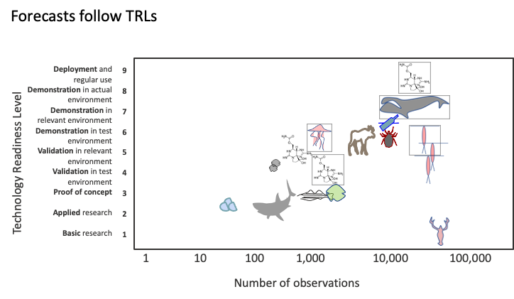

Tandy Center for Ocean Forecasting

Slide 8
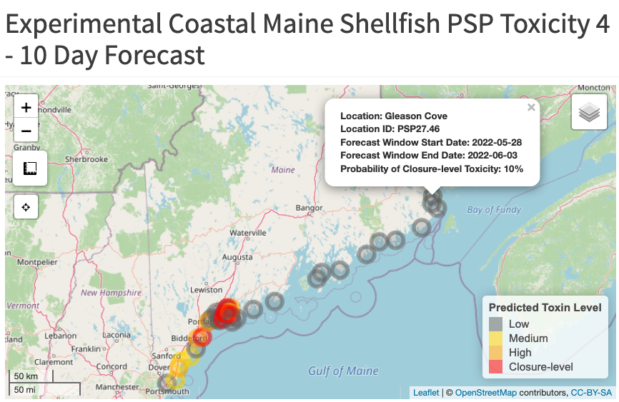
How we use Shiny
No longer available – Added to Maine DMR Shellfish Closure Map for 2024

Slide 9
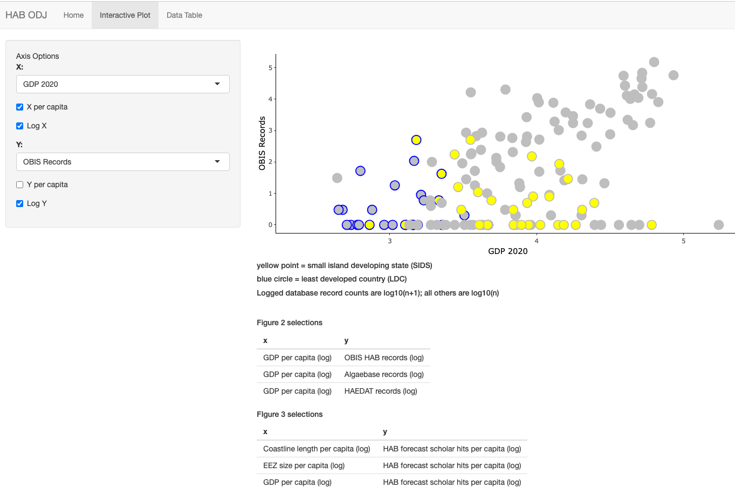

How we use Shiny
Harmful Alagal Bloom –
Ocean Data Justice
https://jevanilla.shinyapps.io/habodj/

Slide 10

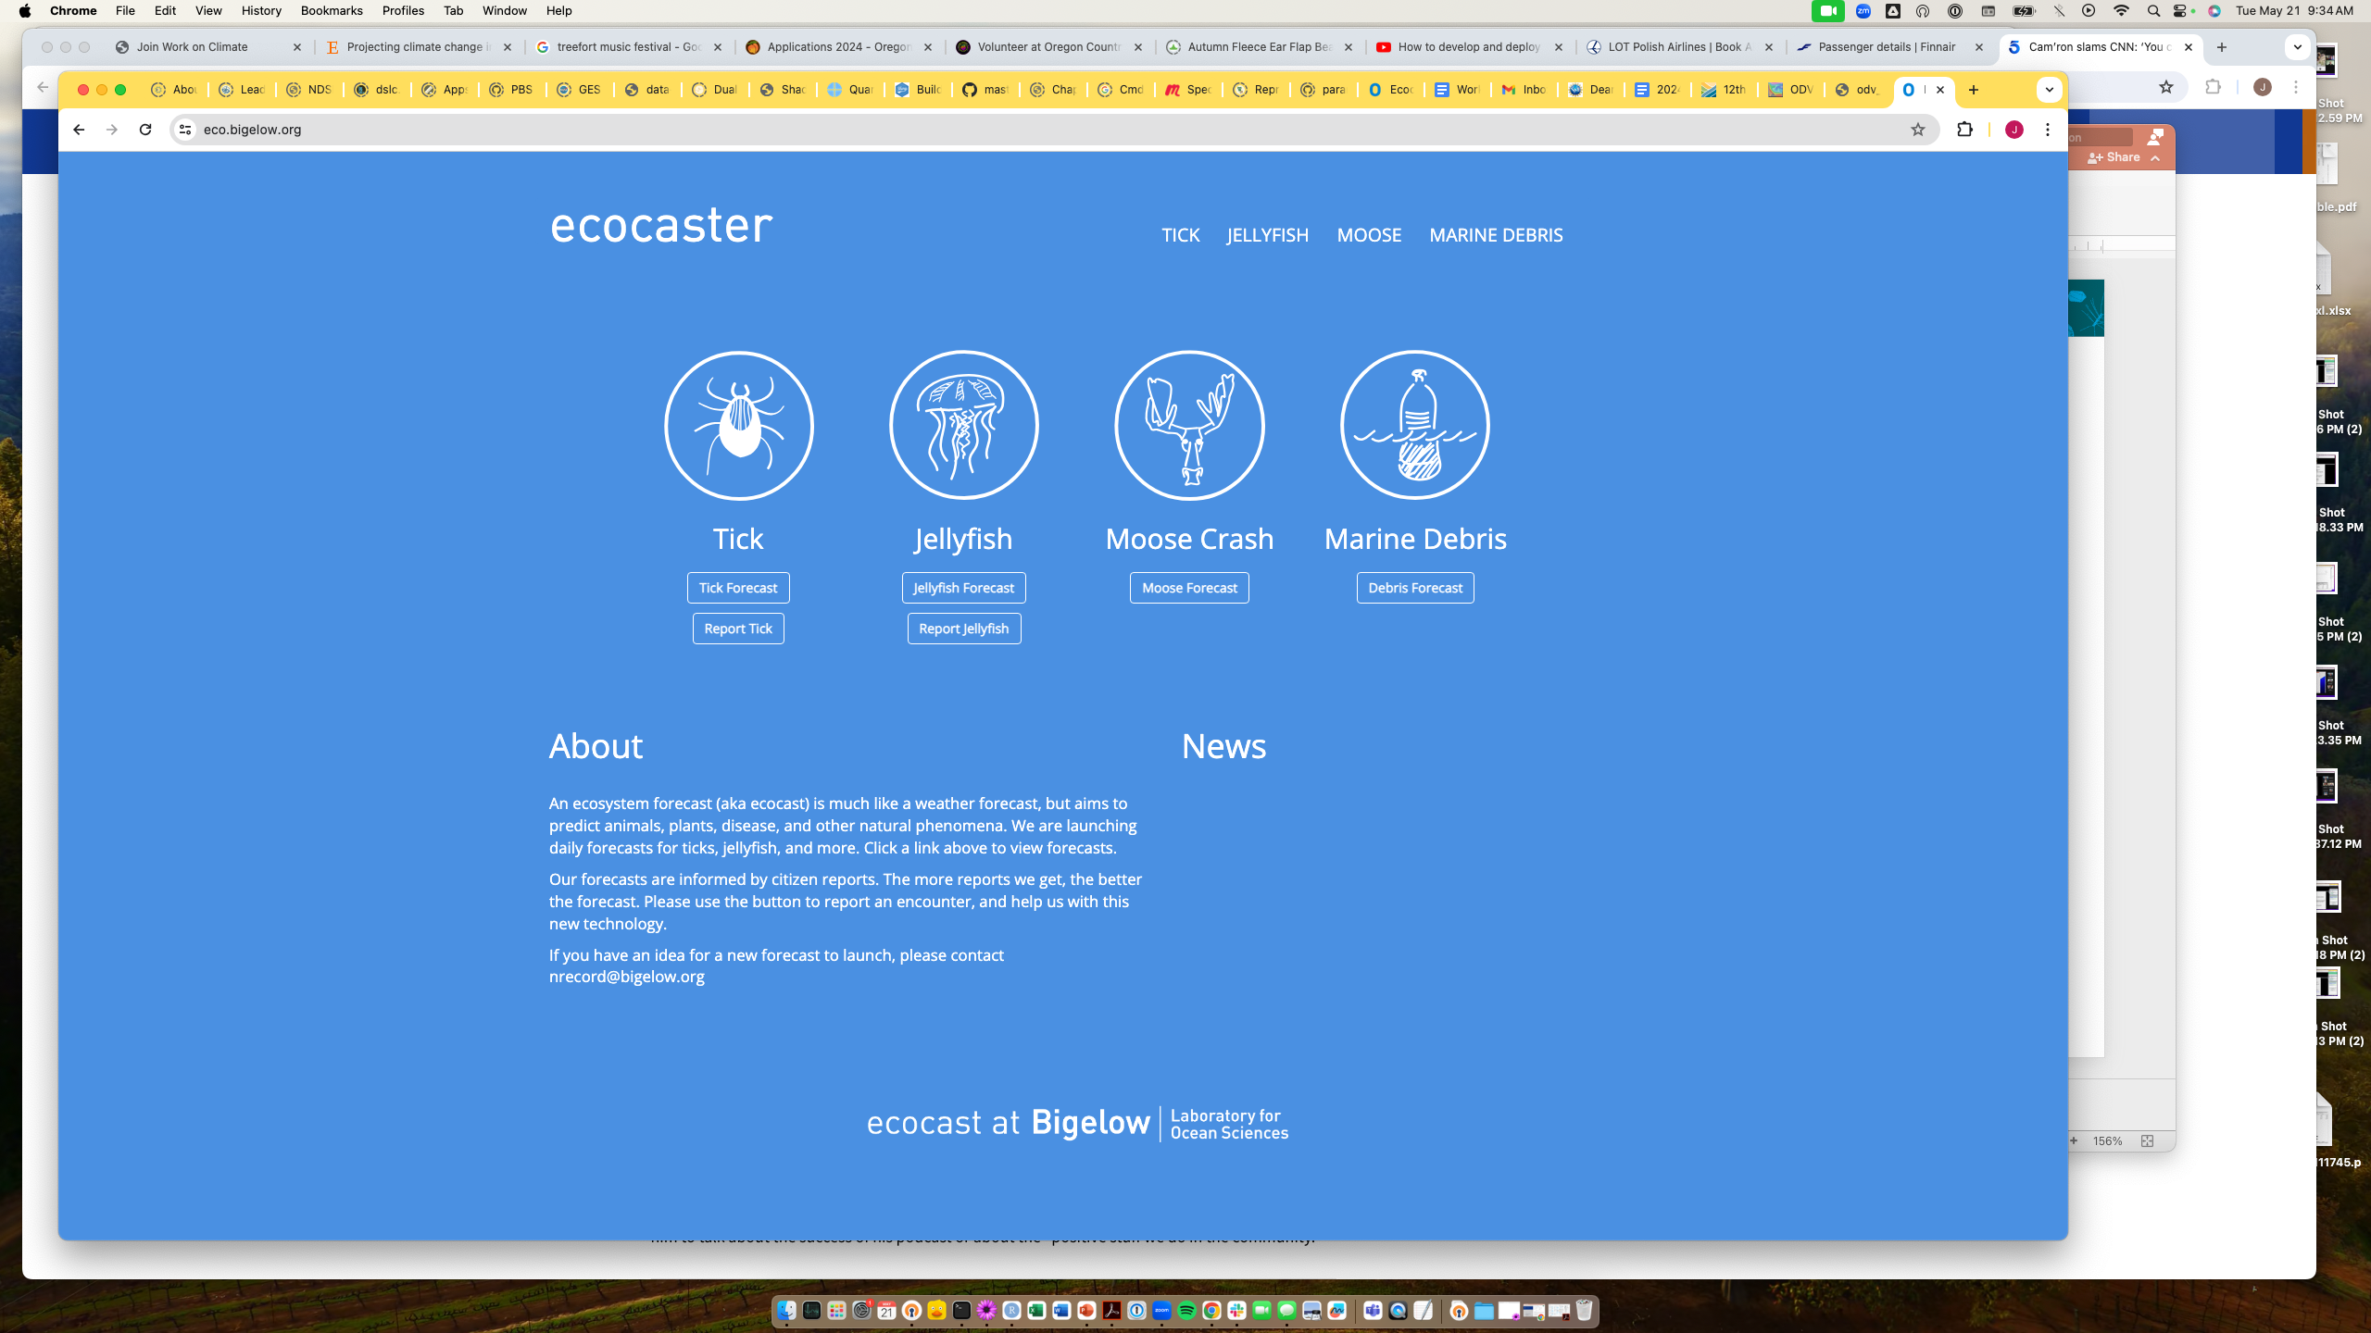

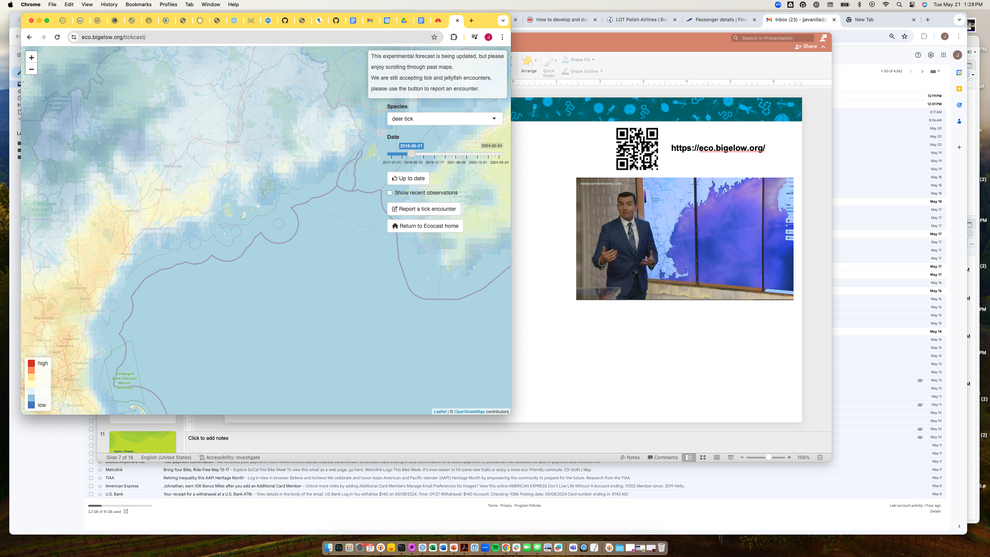
How we use Shiny
https://eco.bigelow.org/

Slide 11





Shiny Intro
+

Slide 12
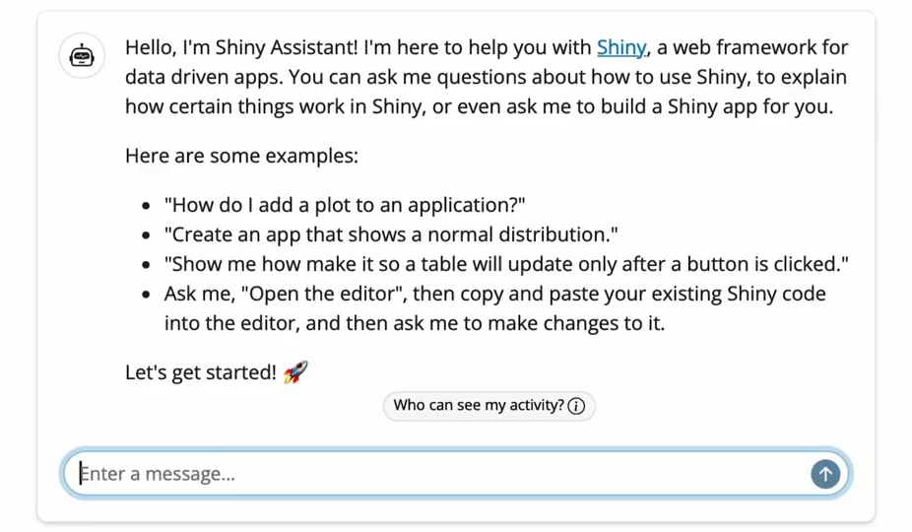
The future -> Shiny Assistant?

Slide 13
Hello Shiny

Slide 14
Inputs + Outputs

Slide 15
Inputs
Family of functions that follow {type}Input()
For example textInput() for collecting text
First argument is always an input ID
Second argument is a label
Refer to inputs in the server using input${ID}

Slide 16
Outputs
Defined by output$ID in the server
Family of output functions that follow:
Server: render{type}()
UI: {type}Output(“id”)
For example: renderText() -> textOutput()

Slide 17
Reactivity

Slide 18
Reactive Expressions
Takes an input and returns a value
Cache their value to reduce computation
Reduces duplicate code
Can be called elsewhere (like a function)
`name`<- reactive({})
name()

Slide 19
React Based on Event
Reactive expression triggered by an event
(ie recalculate a value)
Use eventReactive(input, {})
Perform an action in response to an event
(ie update something in the UI)
Use observeEvent(input, {})
Notes:
An eventReactive creates an object that you define like reactive does, but with out usual chain-reaction behavior you get from reactive. However it is lazily evaluated and cached like the other reactives.
An observeEvent can not create an object that you define (it creates something else). It is immediately evaluated and not cached. It is for causing side-effects.
So if you need a data frame, or vector, or plot or something, but want to decouple from the usual reactive chain-reactions, use eventReactive.
If you just want to cause an immediate side effect, observeEvent is your ticket.
https://stackoverflow.com/questions/33519816/shiny-what-is-the-difference-between-observeevent-and-eventreactive

Slide 20
Dynamic UI
Updating your UI using reactive expressions
Family of functions: update{InputType}
For example: updateSelectInput()
Use similar syntax as {type}Input()functions

Slide 21
Tidy Evaluation
R recognizes the difference between .env vs .data variables
x <- “count”
mutate(df, x*10)
mutate(df, .data$x*10)
Shiny context
.data[[input${name}]]

Slide 22
Publishing a Shiny App

Slide 23
Sharing a Shiny App
With other R users
Share the code (github, zip file, etc.)
Use shiny::runGitHub(repo, username)
Or shiny::runGist() to keep things anonymous
Publishing as a web page
Shinyapps.io
Private server
Posit connect

